Slide 1






DataVerse
Africa
CUSTOMS IMPORTS INSIGHTS
Internship Presentation
Presented By:
Rosemary Mtape

Slide 2


Problem Statement
Incomplete, inconsistent, and fragmented trade and customs data hinder efficient revenue collection, compliance monitoring, and trade facilitation. The lack of standardized and accessible trade data limits the ability to analyze import/export trends, optimize customs processes, and ensure accurate revenue generation
Context
Trade and customs data is critical for governments and businesses to monitor cross-border trade, ensure compliance with regulations, and optimize revenue collection. However, inconsistencies in data recording, missing values, and lack of standardization in datasets such as import/export records create challenges in analyzing trade flows and identifying revenue leakages.

Slide 3
Issue
The dataset contains missing values, inconsistent formatting, and lack of granularity in key fields such as Country_of_Supply, Container_Number, Container_Size, and Receipt_Number. Additionally, the Receipt_Date column was initially in an incompatible format, and the Mass(KG) column contained formatting issues (e.g., commas as thousand separators). These issues affect the accuracy, usability, and interoperability of the data for trade and customs analytics
Impact
• Revenue Loss: Incomplete or inaccurate data leads to underreporting of trade values, resulting in revenue leakage for governments.
• Inefficient Customs Processes: Lack of standardized data slows down customs clearance and increases operational costs.
• Poor Decision-Making: Inconsistent data limits the ability to analyze trade trends, identify smuggling or fraud, and optimize trade policies.
• Compliance Risks: Missing or incorrect data makes it difficult to monitor compliance with trade regulations and tariffs.

Slide 4

Project Objectives
Primary Objective
To analyze and clean the Trade and Customs Analytics dataset, ensuring its accuracy, completeness, and usability for trade trend analysis, revenue optimization, and compliance monitoring.
Secondary Objectives
1. Identify and address data quality issues such as missing values, inconsistent formatting, and lack of standardization.
2. Conduct exploratory data analysis (EDA) to uncover trends in import/export data, including FOB values, CIF values, and tax revenues.
3. Provide actionable insights to improve customs processes, revenue collection, and trade facilitation

Slide 5
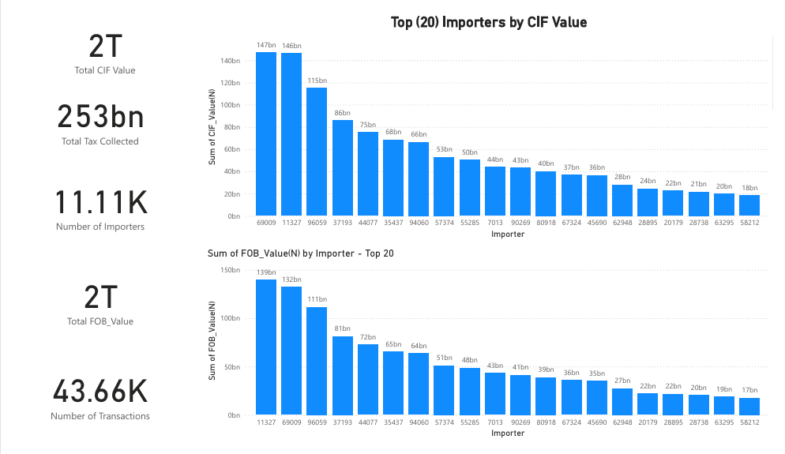
Data Insights
Interactive Dashboard Insights
The dashboard provides a comprehensive overview of the top 20 importers based on Cost, Insurance, and Freight (CIF) value, as well as Free on Board (FOB) value, highlighting the significant role these entities play in trade dynamics. With a total CIF value of 2 trillion and total tax collected amounting to 253 billion, the data underscores the substantial economic impact of these importers. The CIF value indicates the combined cost of goods, insurance, and freight, reflecting the true expense incurred by importers. The analysis reveals that these top importers collectively executed over 11,000 transactions, showcasing their active participation in the market. In parallel, the FOB value mirrors this trend with a total of 2 trillion, emphasizing the high-value nature of these transactions. This data not only identifies leading importers but also highlights areas for potential revenue optimization and strategic focus for customs authorities.

Slide 6
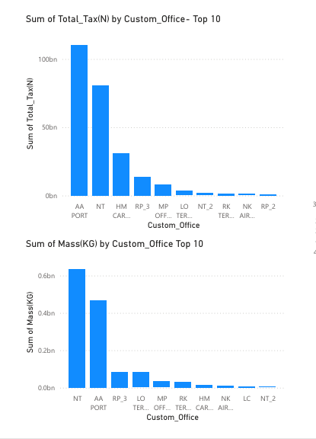
The dashboard provides a detailed analysis of tax collection and mass handled by the top 10 customs offices, revealing significant disparities in revenue generation and operational volume. The bar chart for total tax collected indicates that AA PORT leads dramatically in tax contributions, generating over 100 billion, far surpassing other offices. This highlights AA PORT's critical role in revenue collection and suggests effective operational practices worth emulating. Conversely, the mass handled by each customs office illustrates a different narrative, with AA PORT again at the forefront, but with other offices contributing notable volumes as well. The data underscores the need for further investigation into the operational efficiencies and trade volumes of these customs offices to identify best practices and address any underlying issues affecting tax collection and cargo processing. By optimizing performance at underperforming offices, authorities can enhance overall revenue generation and trade facilitation.

Slide 7
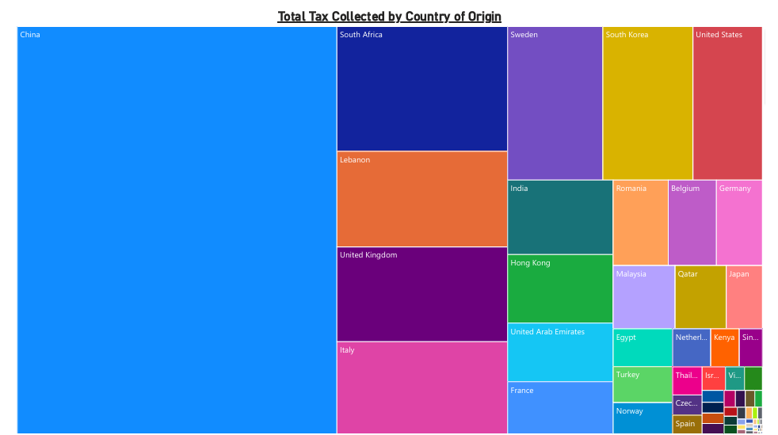
The treemap visualization offers a compelling overview of total tax collected categorized by country of origin, highlighting the dominant role of China in trade activities. The vast area allocated to China indicates that it is the foremost contributor to tax revenues, underscoring its significance as a key player in global trade. Other countries, such as South Africa, South Korea, and the United States, also appear prominently, reflecting their substantial contributions to tax collection. This visualization facilitates a quick comparison of tax revenues generated from various countries, revealing which nations are vital to the customs revenue stream. The insights derived from this data can inform strategic decisions regarding trade partnerships and tax policies, as well as efforts to enhance compliance and maximize revenue collection from high-contributing countries.

Slide 8
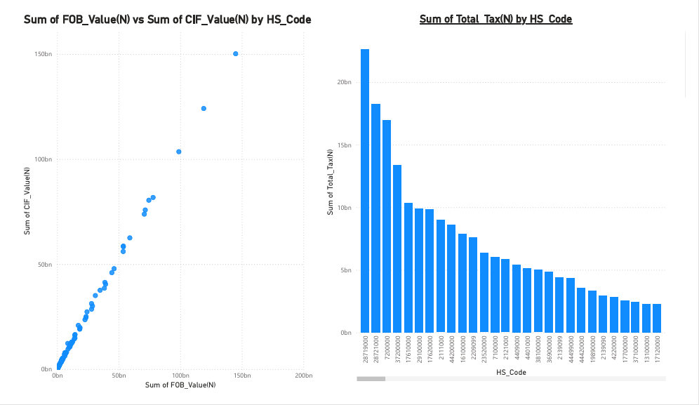
The second dashboard reveals critical insights into the relationship between Free on Board (FOB) value and Cost, Insurance, and Freight (CIF) value, as well as tax collection patterns across different Harmonized System (HS) codes. The scatter plot illustrates a strong correlation between FOB and CIF values, indicating that higher transaction values are typically associated with increased costs, which could reflect the nature of the imported goods. This relationship underscores the importance of accurate valuation in customs processes. Additionally, the bar chart showcasing total tax collected by HS code highlights significant disparities in tax contributions among different product categories. The data reveals that certain HS codes generate substantially higher tax revenues, suggesting targeted opportunities for optimizing tax collection strategies. By focusing on these high-revenue HS codes, customs authorities can enhance compliance and streamline revenue generation efforts.

Slide 9
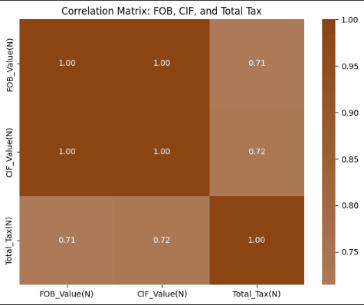
2. Correlation Analysis
The correlation matrix reveals a strong positive relationship between FOB_Value(N), CIF_Value(N), and Total_Tax(N), with correlation coefficients of 0.71 and 0.72 respectively. This indicates that higher FOB and CIF values are closely associated with higher tax revenues, reflecting the direct impact of trade values on tax collection. The strong correlations suggest that optimizing trade volumes and values could significantly enhance tax revenue, while also highlighting the importance of accurate valuation in customs processes

Slide 10
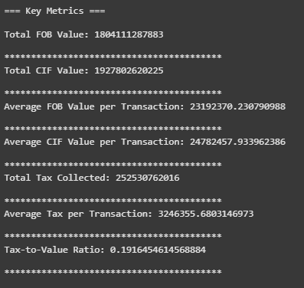
3. Key Metrics
The key metrics reveal significant insights into the trade and customs dataset: the total FOB value (1,804,111,287,883) and CIF value (1,927,802,620,225) indicate a high volume of trade activity, with CIF values including additional costs like insurance and freight. The average FOB (23,192,370.23) and CIF (24,782,457.93) values per transaction suggest the dataset consists of high-value transactions, likely involving premium or bulk goods. A substantial total tax revenue (252,530,762,016) was collected, with an average tax per transaction (3,246,355.68) reflecting significant tax contributions per trade. The tax-to-value ratio of 19.16% highlights that taxes account for nearly 20% of the total cost of goods, indicating a moderate to high tax burden on trade. These metrics underscore the scale of trade activity, the importance of customs revenue, and the potential impact of taxes on trade competitiveness.

Slide 11
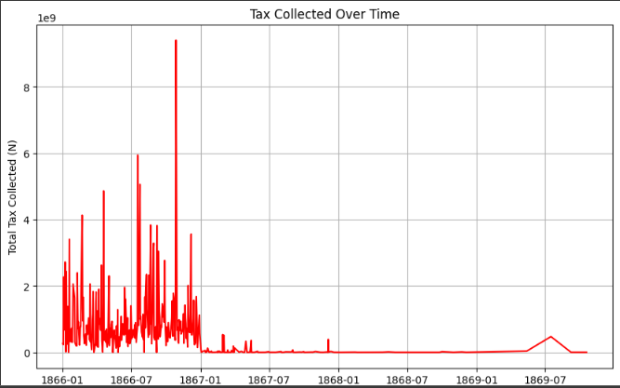
4. Fluctuations in Tax Collection Over Time
The chart shows tax collection trends over time, with noticeable fluctuations between 1866 and 1869. Peaks and troughs in tax
revenue may reflect changes in trade volumes, economic conditions, or policy adjustments during this period. This highlights
the importance of monitoring trade trends and implementing adaptive policies to stabilize and optimize tax revenue collection over
time.

Slide 12
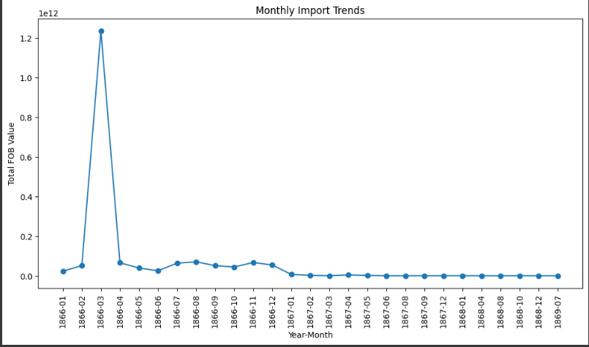
5. Monthly Import Trends
The line graph illustrating monthly import trends presents the cumulative FOB values for each month throughout the study period. A notable spike occurs in January 1866, followed by an even more pronounced peak in March 1866, where total import values exceed 1.2 trillion. This surge likely indicates a significant event or series of factors that led to heightened import activity during those months. After this peak, the graph shows a marked decline in cumulative import values, stabilizing at lower levels for the remaining months. This trend suggests that the remarkable activity in early 1866 was not sustained, potentially reflecting shifts in market conditions or trade policies. Analyzing these aggregated monthly trends can offer valuable insights into historical import dynamics, aiding in the understanding of factors that influence trade volumes over time.

Slide 13
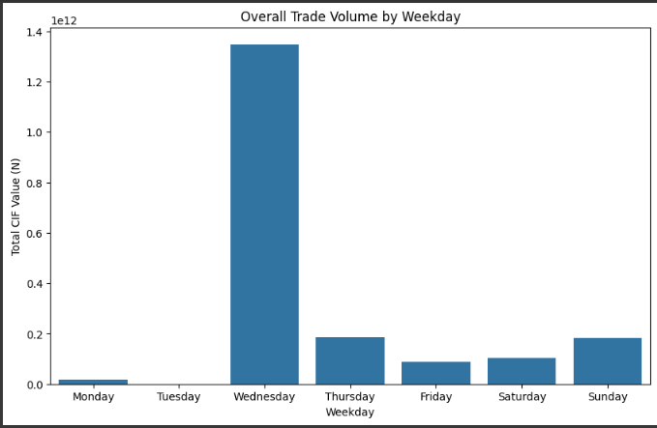
6. Overall Weekday Variations in Trade Volume
The bar chart depicting overall trade volume by weekday illustrates the cumulative CIF values for each day across the study period, revealing significant variations in trade activity. Notably, Wednesday emerges as the clear leader, with a total CIF value exceeding 1.2 trillion, indicating that this day is historically the most active for trade transactions. In contrast, the other weekdays show relatively lower cumulative values, suggesting a more consistent but less intense trading pattern. The marked disparity highlights the potential for targeted operational strategies on Wednesdays to accommodate increased trade volumes, while also considering ways to boost trade activity on less active days. Understanding these weekly trends can assist customs authorities in optimizing staffing, resource allocation, and trade facilitation efforts to enhance overall efficiency throughout the week.

Slide 14
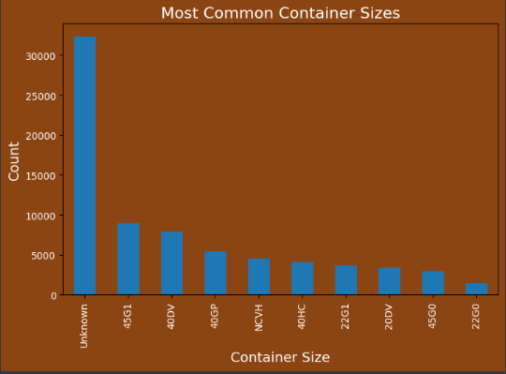
7. Dominance Container Sizes in Trade
The chart highlights the most common container sizes, with "Unknown" being the most frequent, followed by standard sizes like 40HC and 40V. The prevalence of unknown container sizes suggests potential gaps in data recording or standardization, which could impact logistics planning and customs efficiency. The presence of standard sizes like 40HC and 40V reflects their widespread use in global trade, emphasizing the need for better data collection and standardization to optimize trade operations and resource allocation.

Slide 15

Recommendation
Short-Term Recommendations
1. Enhance Data Standardization:
Implement clear guidelines for recording container sizes, HS codes, and other key fields to reduce inconsistencies and missing data.
Example: Standardize container size classifications to minimize "Unknown" entries.
2. Optimize Tax Collection:
Focus on high-value HS codes with lower tax-to-value ratios to ensure fair and efficient revenue collection.
Example: Review tax policies for codes like 2209010 to align with trade volumes and values.
Improve Data Accessibility:
Develop user-friendly dashboards and reporting tools to make trade data more accessible to stakeholders.
Example: Use Power BI to create interactive visualizations for customs offices and policymakers.

Slide 16
Long-Term Recommendations
1. Institutionalize Data Governance:
Establish legal frameworks for data standardization, interoperability, and ethical use across customs offices.
Example: Develop regional data-sharing agreements to enhance cross-border trade efficiency.
2. Invest in Capacity Building:
Train customs officials and data professionals in advanced analytics and data management techniques.
Example: Partner with universities to offer specialized courses in trade analytics.
3. Promote Sustainable Trade Practices:
Encourage the adoption of green technologies and sustainable trade policies to reduce environmental impact.
Example: Incentivize the use of eco-friendly containers and logistics solutions.

Slide 17


Implementation Plan
Short-Term (0-1 Year)
1. Data Standardization:
Develop and enforce guidelines for data entry and classification.
Resources: Data management tools, training programs.
Stakeholders: Customs offices, IT teams, policymakers.
2. Tax Policy Review:
Analyze tax-to-value ratios and adjust policies for underperforming HS codes.
Resources: Tax experts, financial analysts.
Stakeholders: Government agencies, trade associations.
3. Dashboard Development:
Create interactive dashboards for real-time trade data visualization.
Resources: Power BI, data analysts.
Stakeholders: Customs offices, trade regulators.
Hands-on workshops
Case Studies
Simulations

Slide 18
Long-Term (1-5 Years)
1. Data Governance Framework:
Develop and implement regional data-sharing agreements.
Resources: Legal experts, policymakers.
Stakeholders: Governments, trade organizations.
2. Capacity Building:
Launch training programs for customs officials and data professionals.
Resources: Educational institutions, training materials.
Stakeholders: Universities, government training bodies.
3. Sustainable Trade Initiatives:
Promote eco-friendly trade practices and technologies.
Resources: Funding, policy incentives.
Stakeholders: Private sector, environmental agencies
Hands-on workshops
Case Studies
Simulations

Slide 19


Conclusion
The analysis of the Trade and Customs Analytics dataset reveals critical insights into trade volumes, tax collection, and operational efficiencies. Key findings highlight the dominance of high-value HS codes, variations in tax-to-value ratios, and the prevalence of unknown container sizes. These insights stress the urgent need for data standardization, optimized tax policies, and technology-driven solutions to enhance trade efficiency and revenue collection. By implementing the recommended short-term and long-term strategies, stakeholders can effectively address existing data gaps, improve decision-making, and foster sustainable trade practices. Bridging these gaps is essential for enabling evidence-based policies, ensuring efficient resource allocation, and promoting economic growth within the trade and customs sector.

Slide 20
DataVerse
Africa
Thank You

